Slide 1
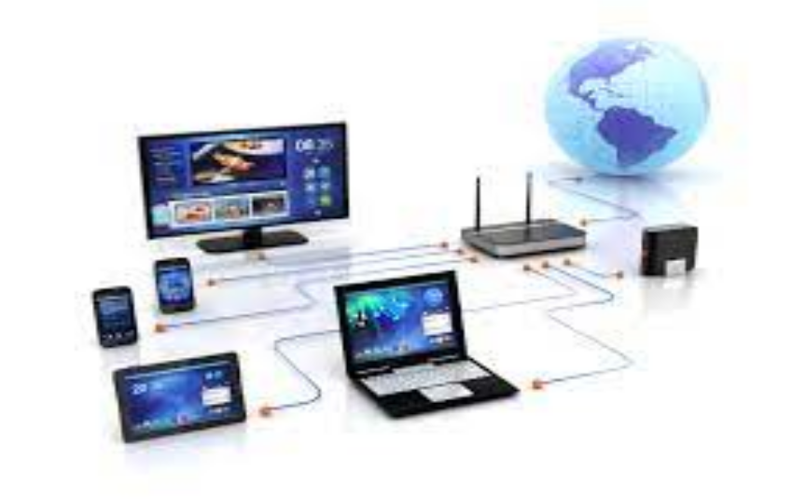
Unit 2.1 - Computer Networks
Prepared by: Koh Kian Hua

Slide 2
Objectives (Part 3)
After completing this unit, students should be able to:
Describe the different hardwares that are used to support a LAN (Local Area Network)
Describe the role and function of a router in a network
Understanding the use of Ethernet and how collisions are detected and avoided
Understanding bit streaming (eg: real time and on-demand)
Appreciate the importance of bit rates / broadband speed on bit streaming

Slide 3
Computer Networks
Hardware Requirements of Networks
Hardware items needed to form a LAN and WAN network includes:
Hub
Switch
Repeater
Router
Bridge.

Slide 4
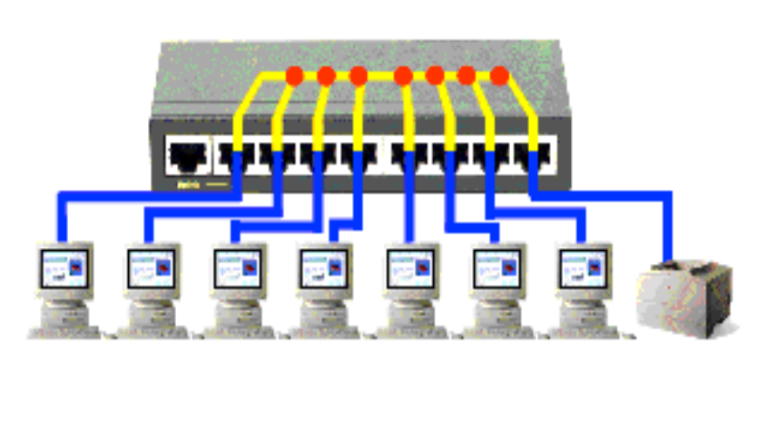
Computer Networks
Hub
Hardware devices that allows computers to connect to them
Often used to from a local area network.
Takes data received at it's ports and sends to all computers in the network
Not a very secure method of data disribution and waste of bandwith

Slide 5
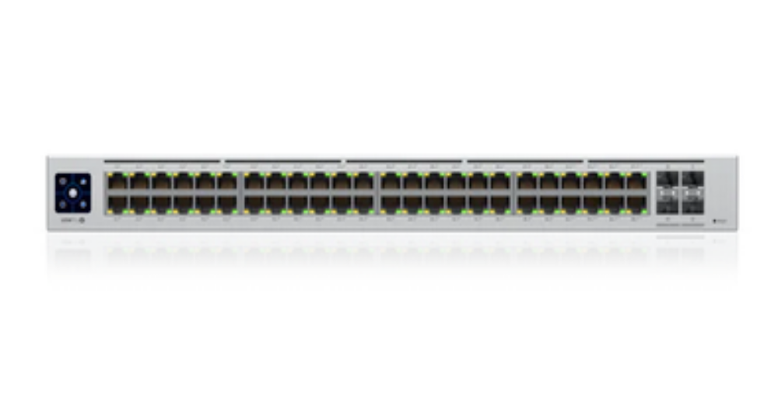
Computer Networks
Switch
Similar to hub, but more efficient in distributing data
It connects devices to form a local area network (LAN).
Unlike the hub, it receives data packet, determines it destination address and sendd data to specific computers only
This make it more secure in distributing data than a hub.

Slide 6
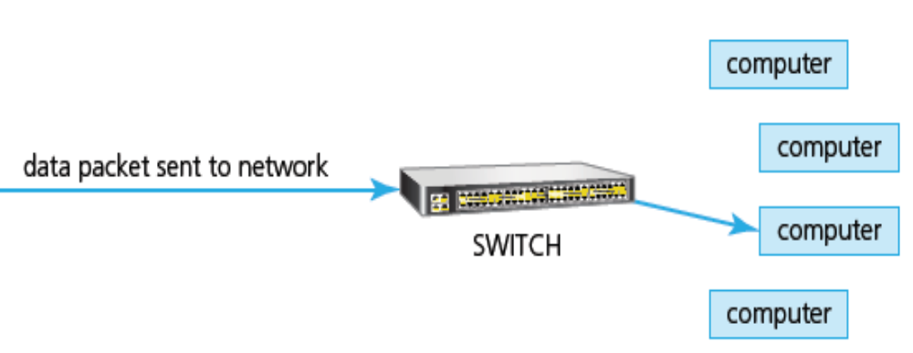
Computer Networks
Switch
Similar to hub, but more efficient in distributing data
It connects devices to form a local area network (LAN).
Unlike the hub, it receives data packet, determines it destination address and send data to specific computers only
This make it more secure in distributing data than a hub.

Slide 7
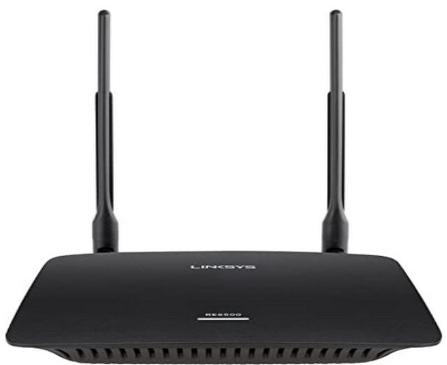
Computer Networks
Repeater
Repeaters are devices which are added to transmission systems to boost the signal so it can travel greater distances.
They amplify signals on both copper cable and fibre optic cable communication links.
Repeaters can also be used on wireless systems (eg: boosting signals to prevent any ‘dead spots’ in the Wi-Fi zone.

Slide 8
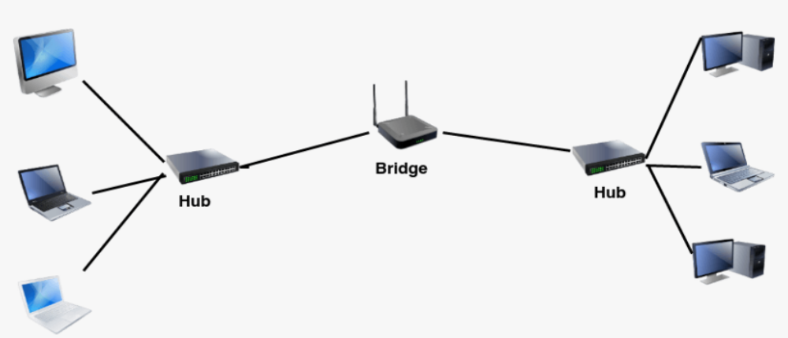
Computer Networks
Bridge
Devices that connect one LAN to another LAN that uses the same protocol (communication rules).
They are often used to connect together different parts of a LAN so that they can function as a single LAN.

Slide 9
Computer Networks
Bridge
Repeaters are devices which are added to transmission systems to boost the signal so it can travel greater distances.
They amplify signals on both copper cable and fibre optic cable communication links.
Repeaters can also be used on wireless systems (eg: boosting signals to prevent any ‘dead spots’ in the Wi-Fi zone.

Slide 10
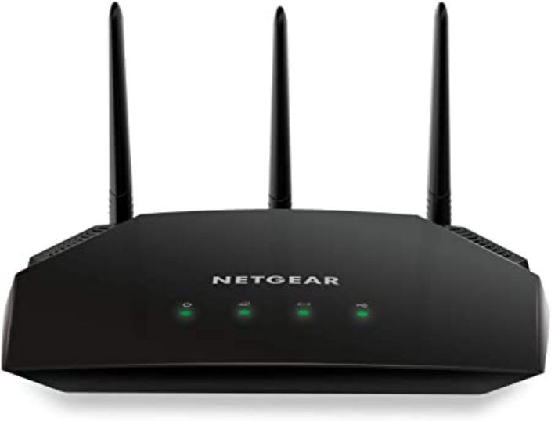
Computer Networks
Router
Function: Routers enable data packets to be routed between the different networks to join a LAN to a WAN. The router takes data transmitted in one format from a network and converts the data to a protocol and format understood by another network, thereby allowing them to communicate via the router.

Slide 11
Computer Networks
Role of Router
Act as a default gateway
Can perform protocol translation; for example, allowing a wired network
Communicate with a wireless (Wi-Fi) network – the router can take an Ethernet data packet, remove the Ethernet part and put the IP address into a frame recognised by the wireless protocol
Can move data between networks
Can calculate the best route to a network destination address.

Slide 12
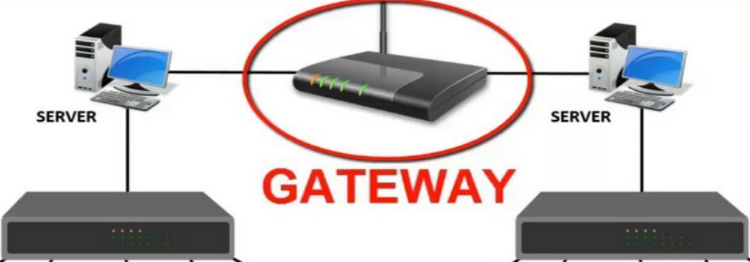
Computer Networks
Gateway
A gateway is a network point that acts as an entrance to another network. It is a key point for data on its way to or from other networks. The gateway converts data packets from one protocol to another. Gateways acts as a device that allows traffic to flow in and out of the networks. Gateways can be wired or wireless devices. Whenever a network node needs to communicate outside its network, it needs to use a gateway.

Slide 13
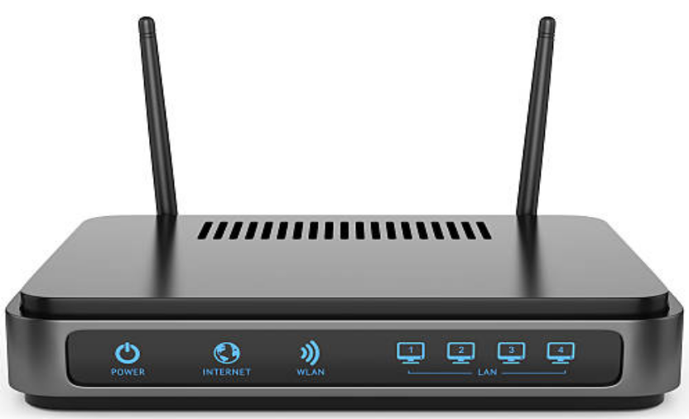
Computer Networks
Modem
Modem allows the transmission of digital data over analogue communication channels. It converts digital data to analogue data. It also does the reverse and converts data received over the analogue network into digital data which can be understood by the computer. Modems transmit data in a modulated form to allow several simultaneous wireless communications to take place without interfering with each other.

Slide 14
Computer Networks
Differences Routers and Gateways
Routers | Gateways
Read each incoming packet of data and decide where to forward the packet | Convert one protocol (or data format) to another protocol (format) used in a different network
Can route traffic from one network to another network | Convert data packets from one protocol to another; they act as an entry and exit point to networks
Used to join LANs together to form a WAN (sometimes called brouters) and also to connect a number of LANs to the internet | Translate from one protocol to another
Offer additional features such as dynamic routing | Do not support dynamic routing

Slide 15
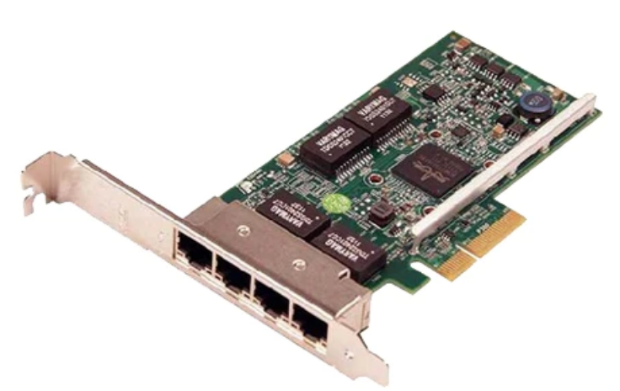
Computer Networks
Network Interfac Card (NIC)
NICs allow a device to connect to a network (such as the internet). It frequently contains the MAC address (device address) generated at the manufacturing stage. Wireless NICs) are the same as the more ordinary NICs and they have an antenna to communicate with networks via microwaves. WNIC work on two modes:
  Infrastructure mode: Requires WAPs (wireless access points) and all the data is transferred using the WAP and hub/switch
  Ad hoc mode does not need to have access to WAPs; it is possible for devices to interface with each other directly.

Slide 16
Computer Networks
Ethernet
Ethernet is a standard communication protocol used to create local area networks. It transmits and receives data through cables. This facilitates network communication between two or more different types of network cables such as from copper to fiber optic and vice versa.
A network using Ethernet is made up of:
  a node (any device on the LAN)
  medium (path used by the LAN devices, such as an Ethernet cable)
  frame (data is transmitted in frames which are made up of source address and destination address – the addresses are often the MAC address).

Slide 17
Computer Networks
IP Address Conflicts
IP Address conflicts may occur when using ethernet.
This may occur if devices on the same network have been given the same IP address; without a unique IP address
It is not possible to connect to a network without a unique address.
This is most likely to occur on a LAN where dynamic IP addresses
may have been used.
Dynamic IP addresses are temporary and may have been assigned to a device on the network, whether another device has the same static IP address.
This is resolved by re-starting the router.

Slide 18
Computer Networks
Collisions
Ethernet supports broadcast messages to all devices connected to a LAN.
Two messages using the same data channel could be sent at the same time, leading to a collision.
Carrier sense multiple access with collision detection (CSMA/CD) was developed to resolve the issue of collision.
When a collision is detected, a node stops transmitting a frame and transmits a ‘jam’ signal.
It then waits for a random time interval before trying to resend the frame.

Slide 19
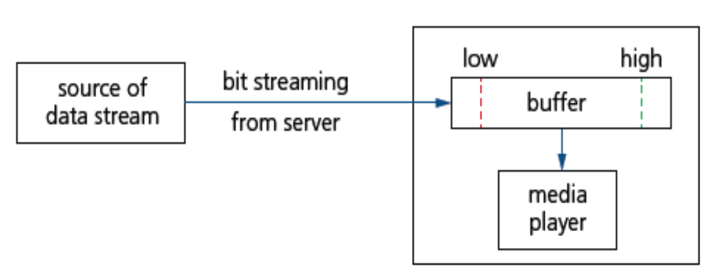
Computer Networks
Bit Streaming
Bit streaming is a sequence of digital bits sent over the internet or a network that requires a high speed data communication link
It involves very large files (such as video) and hence the files to undergo some data compression before transmission.
It is also necessary to have buffering to ensure smooth playback of the media files.
A buffer is a memory used to temporarily store data while it is being moved from one place to another.

Slide 20
Computer Networks
Network Buffering
Why is network buffering useful ?
Buffering aids in matching the speeds of the different devices: the device sending the data and the device receiving the data.
Buffering helps devices with different data transfer sizes adapt to one another.
When large data files are transferred between devices, the data is broken into small fragments.
The buffer receives, manipulates, and reassembles these fragments, allowing for files of any size to be transferred effectively

Slide 21
Computer Networks
Pros and Cons of Bit Streaming
Pros of Bit Streaming | Cons of Bit Streaming
No need to wait for a whole video or music file to be downloaded before watching or listening | Cannot stream video or music files if broadband connection is lost
No need to store large files on your device | Video or music files will pause to allow the data being streamed to ‘catch up’ if there is insufficient buffer capacity or slow broadband connection
Allows video files and music files to be played on demand (as required) | Streaming uses up a lot of bandwidth
No need for any specialist hardware | Security risks (eg: malware or virus) associated with downloading files from the internet
There is piracy protection (harder to copy streamed files than files stored on a hard drive) | Copyright issues

Slide 22
Computer Networks
On-Demand vs Real-time Bit Streaming
Bit streaming can be either on demand or real time.
On Demand | Real Time
Digital files stored on a server are converted to a bit streaming format | An event is captured by camera and microphone and is sent to a computer.
A link to the encoded video/music file is placed on the web server to be downloaded. | The video signal is converted (encoded) to a streaming media file.
The user clicks on the link and the file is downloaded in a contiguous (adjacent) bit stream. | The encoded file is uploaded from the computer to the dedicated video streaming server.
Because it is on demand, the streamed video/music is broadcast to the user as and when required. | The server sends the encoded live video to the user’s device.
It is possible to pause, rewind and fast forward the video/music if required. | Since the video footage is live it is not possible to pause, rewind or fast forward.

Slide 23
Computer Networks
Class Activity
Explain how collisions are handled over the Ethernet
What are the differences between on-demand and real-time bit streaming ?

